Slide 1


Direct Speech
and
Indirect Speech

Slide 2
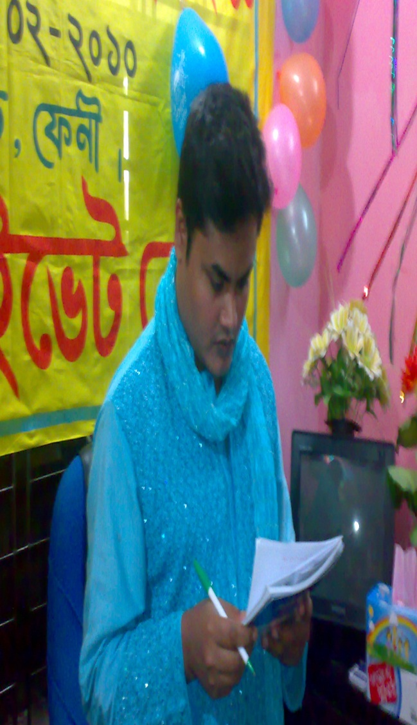
me
MD.Nasir uddin (Bahar)
Assistant teacher (English)
Jamila Khatun Chowdhury High School.
Mobile:01817204698
E-mail:baharfeni100@yahoo.com

Slide 3

DIRECT AND INDIRECT SPEECH
1. STATEMENT
2. COMMAND
3. QUESTION

Slide 4
THE CHANGES OF TOBE & AUXILIARY VERBS
DIRECT
Am, is, are
Shall/will
Can
May
Must
Have/has to
Ought to
INDIRECT
Was/were
Should/would
Could
Might
Had to

Slide 5
CHANGES OF ADVERB OF TIME & PLACE
DIRECT
NOW
TOMORROW
NEXT WEEK
TONIGHT
TODAY
YESTERDAY
LAST NIGHT
LAST WEEK
HERE
THIS
THESE
INDIRECT
THEN
THE NEXT DAY
THE FOLLOWING WEEK
THAT NIGHT
THAT DAY
THE PREVIOUS DAY
THE PREVIOUS NIGHT
THE PREVIOUS WEEK
THERE
THAT
THOSE

Slide 6
CHANGES OF TENSES
DIRECT
SIMPLE PRESENT
SIMPLE PAST
PRESENT PERFECT
PRESENT CONTINUOUS
PRESENT PERFECT CONT.
SIMPLE FUTURE
INDIRECT
SIMPLE PAST
PAST PERFECT
PAST PERFECT
PAST CONTINUOUS
PAST PERFECT CONTINUOUS
PAST FUTURE

Slide 7
1. STATEMENT
HE SAID
HE SAID TO ME
HE TOLD ME
THAT
REPORTED WORDS

Slide 8
STATEMENT EXAMPLE
DIRECT
They said to me, “we are going to visit Barisal tomorrow.”
Jafor said, “I didn’t go to school today.
Sumi told Akash, “My father got angry with me last night.
INDIRECT
They said to me that they were going to visit Barisal the nex day.
Jaforsaid that he hadn’t gone to school that day.
Sumi told Akash that her father had got angry with her the previous night.

Slide 9
STATEMENT Exception:
If the introductory sentence is in the Present Tense, there won’t be any changes in the Reported (Indirect) speech .
DIRECT
Sumon says, “ I will come to your house tonight.”
Indra says,“I have seen that film twice.”
“Dola says: “I meet my friend every Saturday.”
Chandra says: “I don’t like sport.”
INDIRECT
Sumon says that she will come to my house tonight
Indra says that he has seen that film twice.
Dola says that she meets her riend every Saturday.
Chandra says that she doesn’t like sport.

Slide 10
2. COMMAND
a. Possitive Command:
HE ASKED ME
HE TOLD ME
TO
INFIVITIVE

Slide 11
COMMAND EXAMPLE
DIRECT
The teacher asked me, Open your book.”
Sima asked Manu, “Give me a piece of paper.”
“Rony told him, “Call me tonight.”
INDIRECT
The teacher asked me to open my book.
Sima asked Manu to give her a piece of paper.
Rony told him to call him that night.

Slide 12
2. COMMAND
b. Negative Command:
HE ASKED ME
HE TOLD ME
NOT TO
INFIVITIVE

Slide 13
COMMAND EXAMPLE
DIRECT
Sana asked Emon, “Don’t leave me alone anymore.”
Bimala asked Indra, “Don’t hurt me anymore.”
Subho told them, “Don’t disturb me.”
INDIRECT
Sana asked Emon not to leave her alone anymore.
Bimala asked Indra not to hurt her anymore.
Subho told them not to disturb him.

Slide 14
QUESTION
a. Yes / No Question
HE ASKED ME
IF/WHETHER
S + V + COMPLEMENT

Slide 15
A. Yes/No Question Example
DIRECT
Rocky asked Helen, “Does your father work here?”
Mr. Jamal asked Cinthia, “Have you collected your homework?”
Samia asked Peuly, “Can you accompany me to Dhaka tonight?
INDIRECT
Rocky asked Helen if/whether her father worked there.
Mr. Jamal asked Cinthia if/whether she had collected her homework.
Samia asked Peuly if/whether she could accompany her to Dhaka that night.

Slide 16
QUESTION
b. Wh- Question
HE ASKED ME
WHEN/WHAT
etc.
S + V + COMPLEMENT

Slide 17
b. Wh- Question Example
DIRECT
The girl asked me, “Where do you come from?”
My father asked my brother, “Why did you arrive at home late last night?”
Harun asked the girl, “Who is your favoruite movie star?
INDIRECT
The girl asked me where I came from.
My father asked my brother why he had arrived at home late the previous night.
Harun asked the girl who her favourite movie star was.

Slide 18
EXERCISES
DIRECT
The students said to the teacher, “We haven’t done our assignment.”
My uncle said to my sister, “I won’t be able to come to your birthday party next month.”
Palak asked Leena, “Do you know me?”
My father asked me,”Have you prepared for your final exam?
Anita told Rakesh, “Don’t tell me more about your friend.”
My friend asked me, “Stay with me for sometime .”
The man asked me, “ Where do you live?”

Slide 19




Thank you for bearing with me.
Good bye

